Slide 1


Network protocols & security
24EC2210
Topic:
Subnetting
Session – 15

Slide 2



AIM OF THE SESSION
To familiarize students with the concepts of Subnetting.
INSTRUCTIONAL OBJECTIVES
This Session is designed to:
Describe the need for subnetting.
Describe the concepts of subnetting.
LEARNING OUTCOMES
At the end of this session, you should be able to:
Understand the need for subnetting.
Divided the network into different subnets.

Slide 3
AGENDA
Subnetting
Subnet mask
Subnetting problems

Slide 4
Subnetting
Subnetting is the process of creating a subnetwork (also known as a subnet) within a network.
Network interfaces and devices within a subnet can communicate with each other directly.
Routers facilitate communication between different subnets.

Slide 5
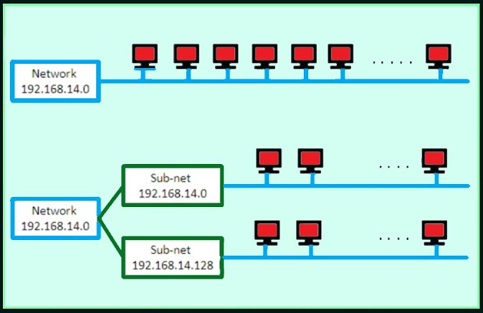
In subnetting, a network is divided into several smaller subnetworks (subnets) with each subnetwork having its own subnetwork address.

Slide 6
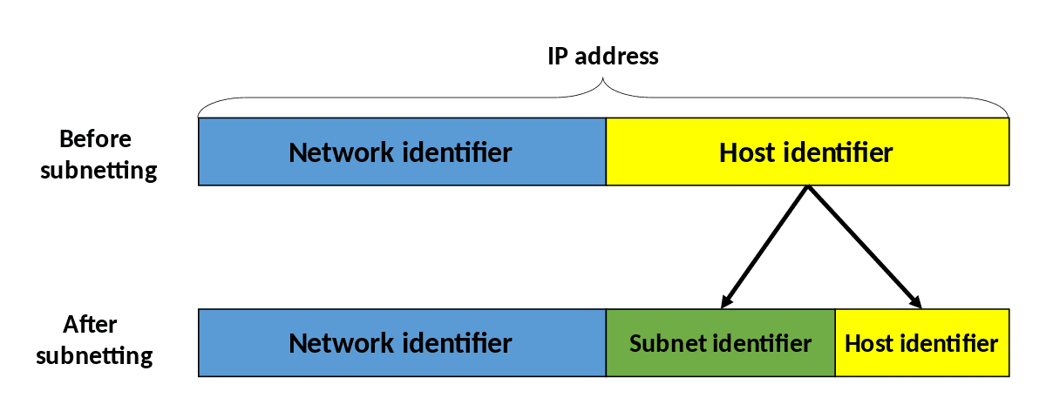
Subnetting…

Slide 7
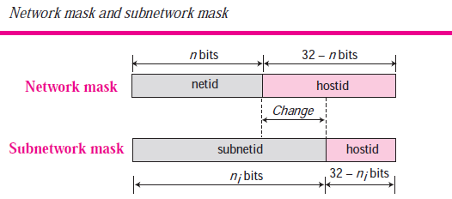
Three level addressing: Subnet mask
Subnetting increases the length of the netid and decreases the length of hostid.
When we divide a network to s number of subnetworks, each subnet will have equal numbers of the Hosts.

Slide 8
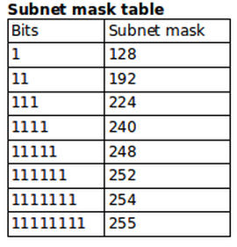
Subnet mask table

Slide 9
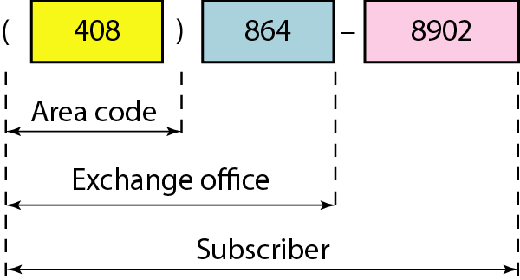
hierarchy in an IPv4 address

Slide 10
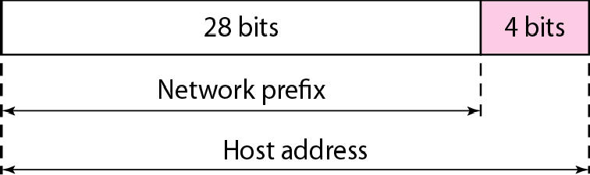
Two levels of hierarchy in an IPv4 address

Slide 11
Each address in the block can be considered as a two-level hierarchical structure:
the leftmost n bits (prefix) define the network;
the rightmost 32 − n bits define the host.

Slide 12
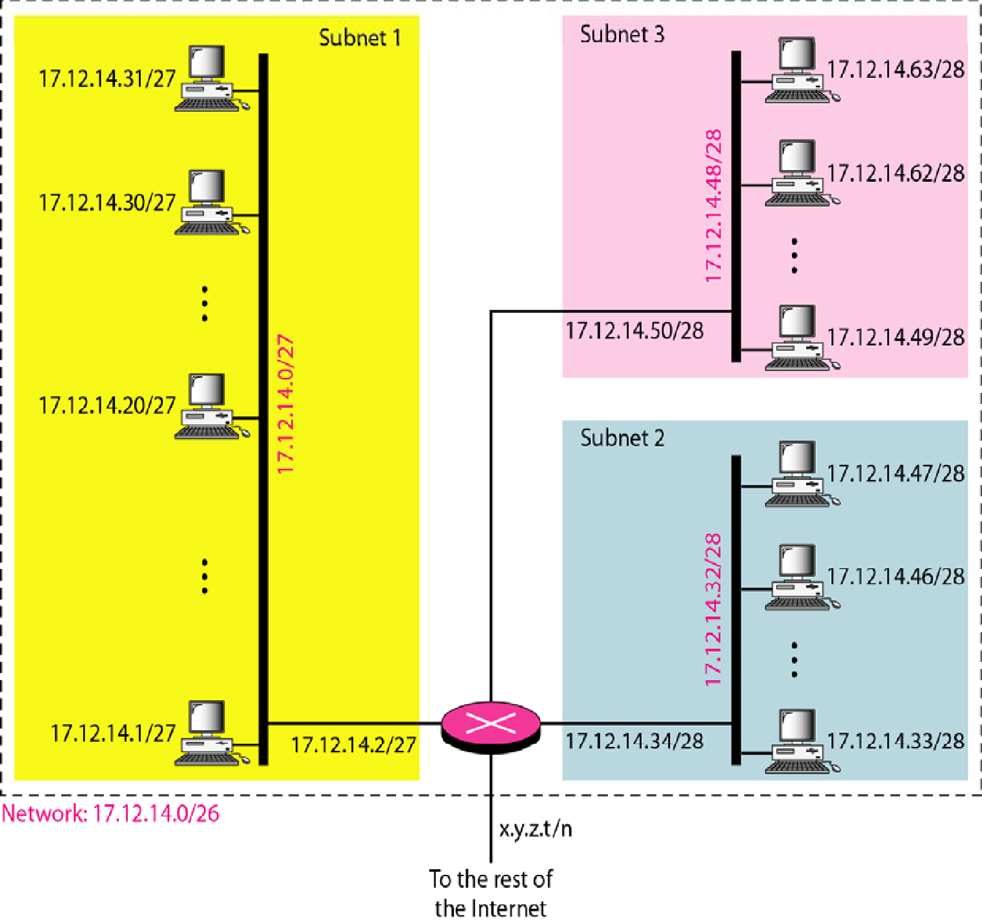
Configuration and addresses in a subnetted network

Slide 13
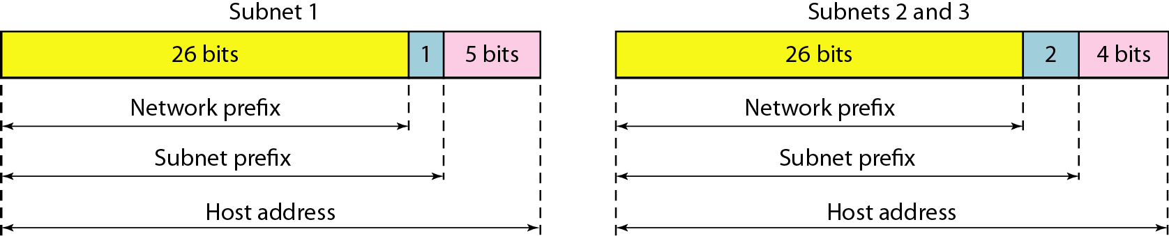
Three-level hierarchy in an IPv4 address

Slide 14
Example
An ISP is granted a block of addresses starting with 190.100.0.0/16 (65,536 addresses). The ISP needs to distribute these addresses to three groups of customers as follows:
The first group has 64 customers; each needs 256 addresses.
The second group has 128 customers; each needs 128 addresses.
The third group has 128 customers; each needs 64 addresses.
Design the subblocks and find out how many addresses are still available after these allocations.

Slide 15


Example (continued)
Group 1
For this group, each customer needs 256 addresses. This means that 8 (log2 256) bits are needed to define each host. The prefix length is then 32 − 8 = 24. The addresses are

Slide 16
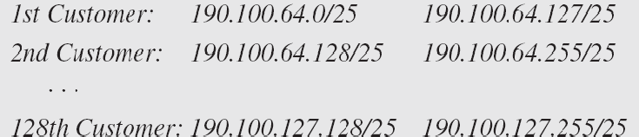
Example (continued)
Group 2
For this group, each customer needs 128 addresses. This means that 7 (log2 128) bits are needed to define each host. The prefix length is then 32 − 7 = 25. The addresses are

Slide 17

Example (continued)
Group 3
For this group, each customer needs 64 addresses. This means that 6 (log₂64) bits are needed to each host. The prefix length is then 32 − 6 = 26. The addresses are
Number of granted addresses to the ISP: 65,536 Number of allocated addresses by the ISP: 40,960 Number of available addresses: 24,576

Slide 18
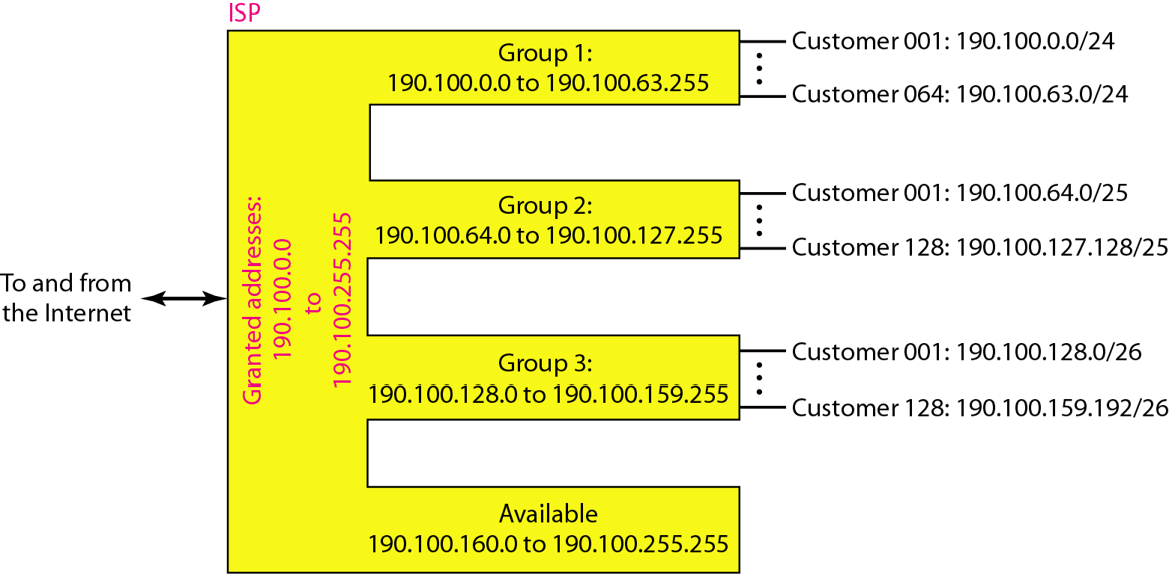
An example of address allocation and distribution by an ISP

Slide 19
Example-1
Assume Class-C Address 198.151.15.10. Say the network is divided into 4 subnets. Calculate the subnet mask. Identify the subnet id, broadcast id, first three and last three host addresses of each subnet.

Slide 20
Example-2
Divide the network into two subnets using variable length subnetting for the network 192.10.25.130/26 give the first host ID, last host ID, Subnet mask and network address.

Slide 21
REFERENCES FOR FURTHER LEARNING OF THE SESSION
Reference Books:
1. Data Communications and Networking, Behrouz A. Forouzan, 4th Edition, McGraw Hill.
2. Computer Networks, Tanenbaum, 6th Edition, Pearson.
Sites and Web links:
CISCO Academy
NPTEL, Computer Networks and Internet Protocols, Prof. Soumya Kanti Ghosh, Prof. Sandip Chakraborty IIT Kharagpur. (https://nptel.ac.in/courses/106105183)

Slide 22
THANK YOU
Team – Networks Protocols & Security

